Slide 1
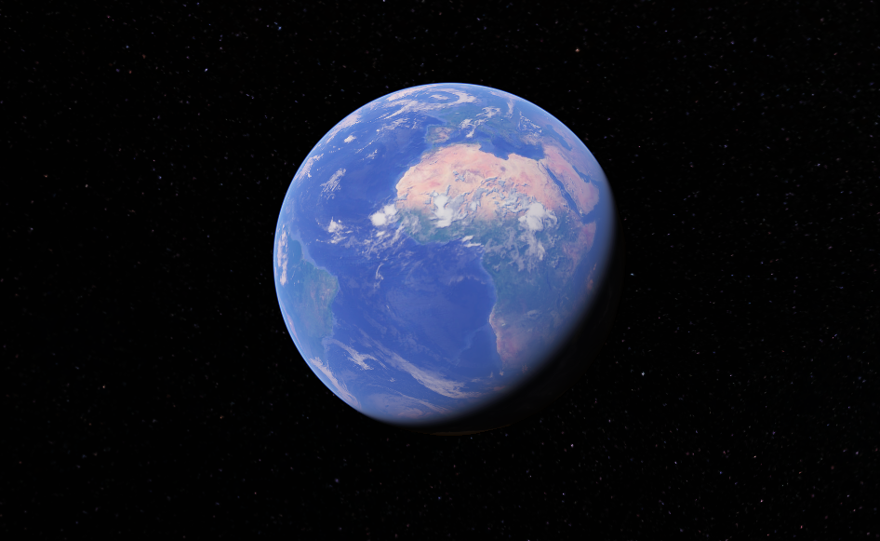
Activity 4 – Measuring Area from Images
LEO, Kenneth M.
2015 – 13015
AP 186
August 22, 2019
Ma’am Maricor Soriano

Slide 2


Regular Geometric Shapes used:
Circle
Square

Slide 3
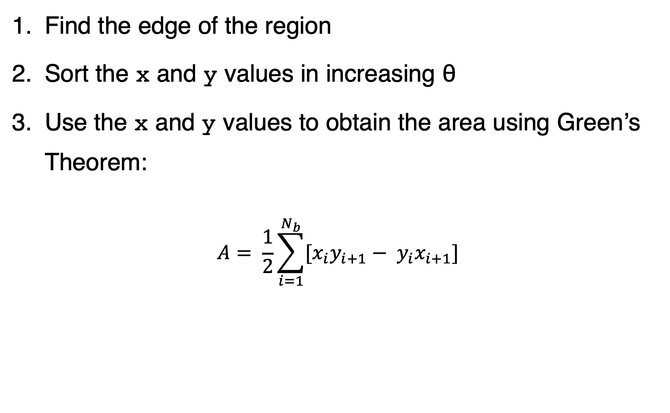
How to measure the area? A step-by-step guide
Find the edge of the region
Sort the x and y values in increasing θ
Use the x and y values to obtain the area using Green’s Theorem:
$$A= \frac{1}{2}\sum_{i=1}^{N_{b}}{[x_{i}y_{i+1}− y_{i}x_{i+1}]}$$

Slide 4
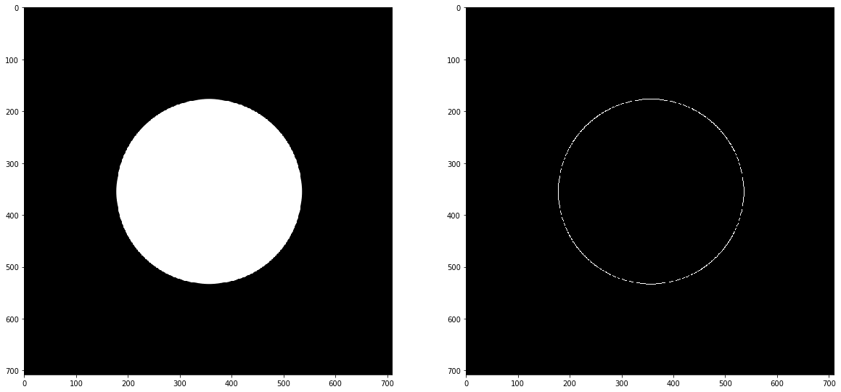
1. Find the edge of the region
Using the cv2 package from Python, the Canny algorithm was used to find the edge of the circle.
We can also find the center and radius of the circle using the x and y values. In this specific example, the radius is equal to 179 pixels, which means that the theoretical area is equal to 100659.77 pixel².

Slide 5
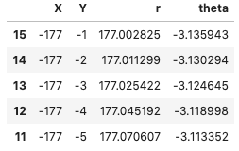
2. Sort the x and y values in increasing θ
Since we know the x and y values of the edge, we can solve for the r and θ values. Here is a summary of the values:
After sorting the values, we can now solve the area under the curve (or in this case, within the edge) using Green’s Theorem.

Slide 6
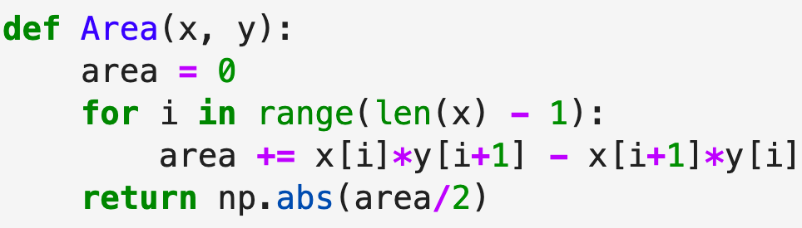
3. Use the x and y to obtain the area
Now we apply the Green’s theorem. The clip of code below shows how I implemented Green’s theorem.
The area measured using Green’s theorem is equal to 99736.5 pixel². Comparing this to the theoretical value, it has a percent deviation of just 0.917%.

Slide 7
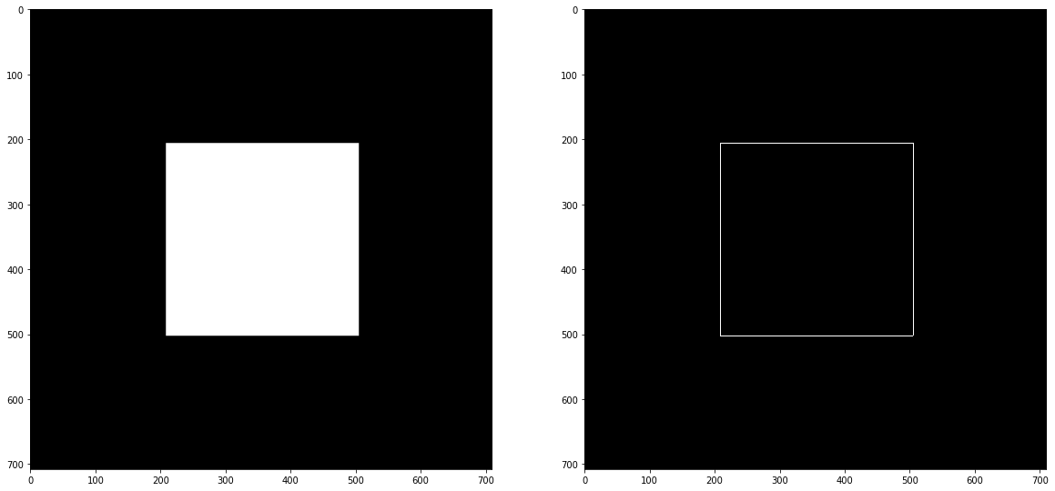
Second Example: Square
Theoretical area
- 88804 pixel²
Green’s theorem:
- 88133 pixel²
Percent error:
- 0.756%

Slide 8
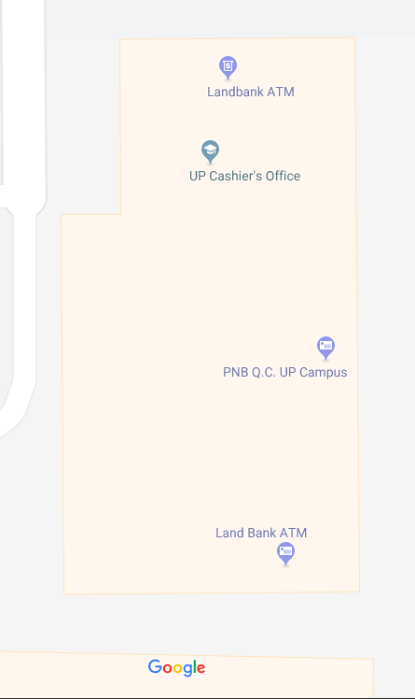
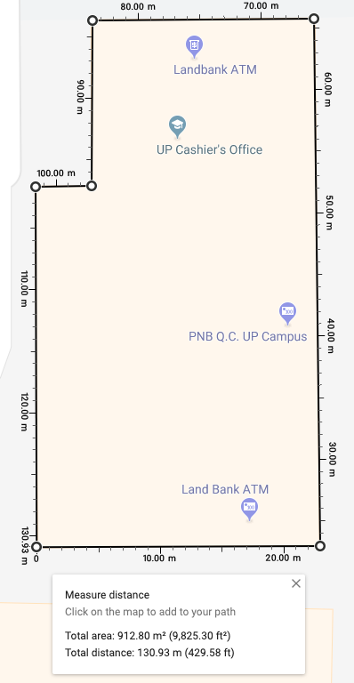
Applying Green’s Theorem to Maps…
I used the building of UP Cashier’s Office since it looks simple enough to apply the concepts that I enjoyed learning by doing this activity. To find the theoretical area, I used the built in measuring tool of google maps.
I also used the photo with the scales to make a calibration curve in order to convert the x and y pixel values of the edge of the building to meters.

Slide 9
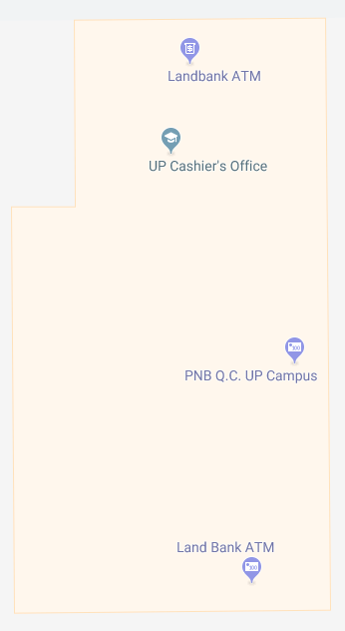

Applying Green’s Theorem to Maps…
I preprocessed the image to remove the labels of the building, in order for my program to correctly identify the edges of the building.

Slide 10
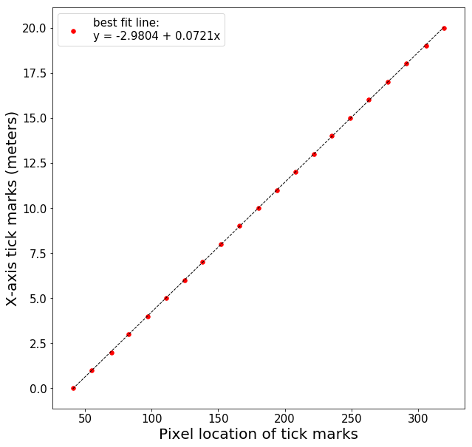
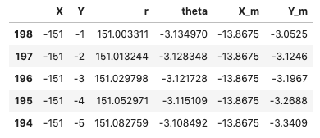
Continuation…
Now we solve for the x and y values of the edge of the building. Then, using the scaled picture, a calibration curve was created to covert the values in meters (X_m, Y_m). Then we apply the Green’s theorem to these values Note that the scale of google maps is the same even if you change the orientation of the image.

Slide 11
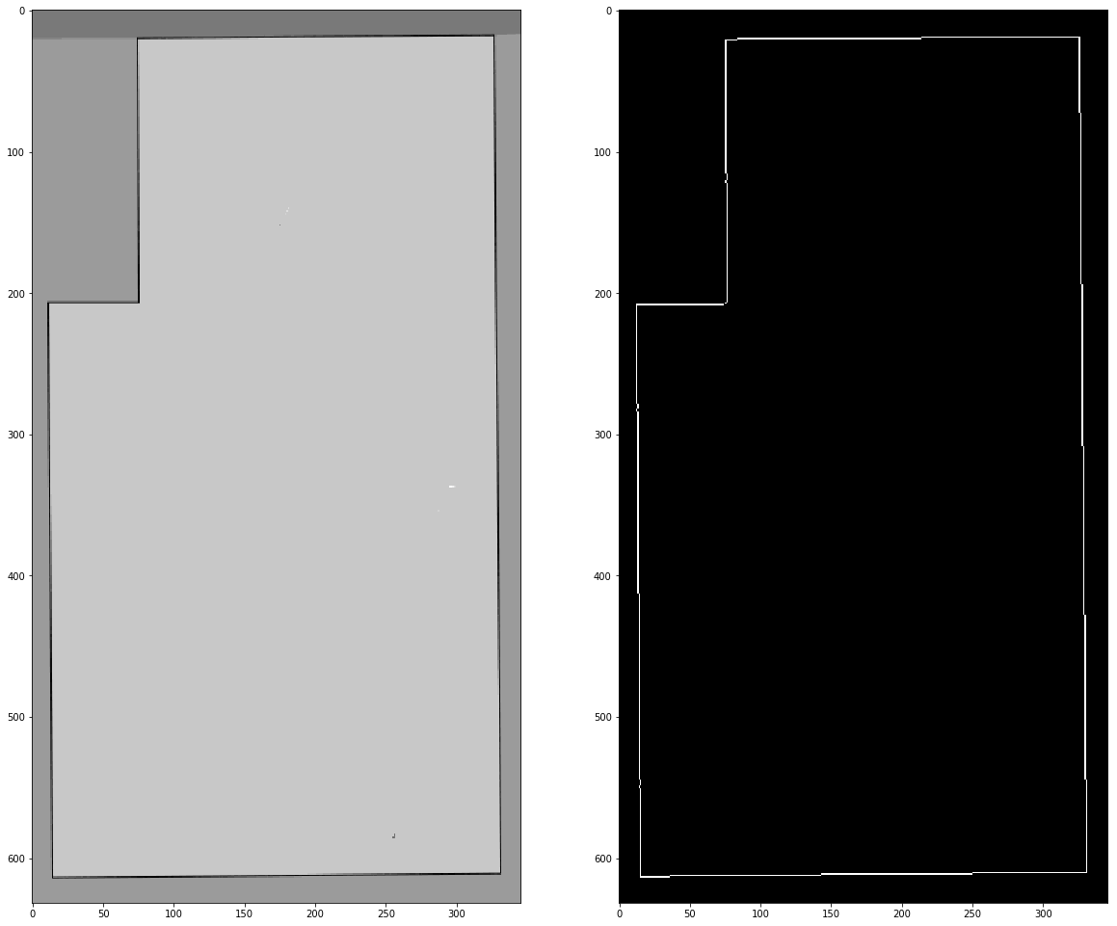
Finally…
Theoretical value:
- 912.80 m²
Area using Green’s Theorem:
- 903.73 m²
Percent error:
- 0.99%

Slide 12
Conclusion:
We can see that we can use the Green’s Theorem to estimate the area of enclosed regions. These estimations are accurate proven by the small percent deviations from the theoretical values.

Slide 13
Self-evaluation
Technical Correctness = 5 / 5
Quality of Presentation = 5 / 5
Initiative = 2
Helped my classmates in their coding problems
Made a program that can be easily understood
Used the previous learnings and applied it to this activity
Studied Green’s theorem in advance
Link to Jupyter Notebook used: http://tiny.cc/Activity4AP186

